Slide 1
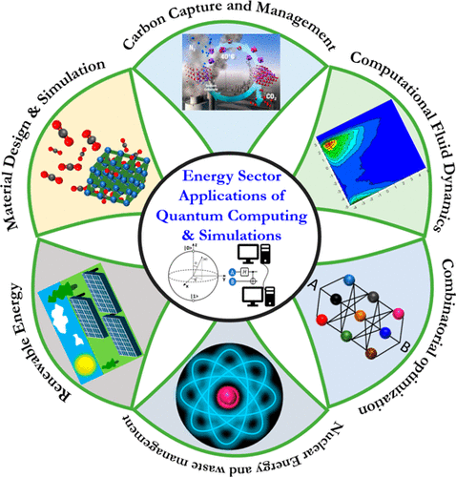
FIGURE 1 – Energy sector applications of quantum computing and stimulations

Slide 2
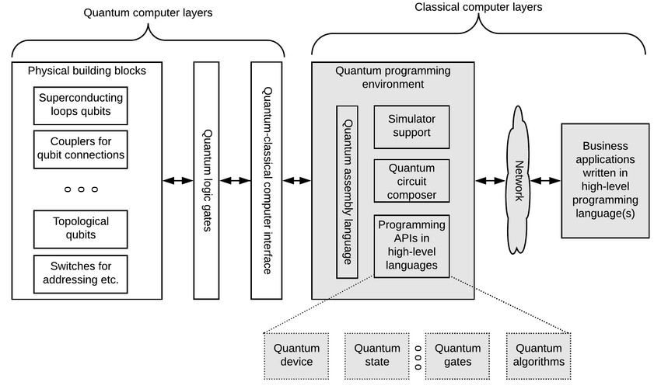
FIGURE 2- Applications of quantum computing

Slide 3
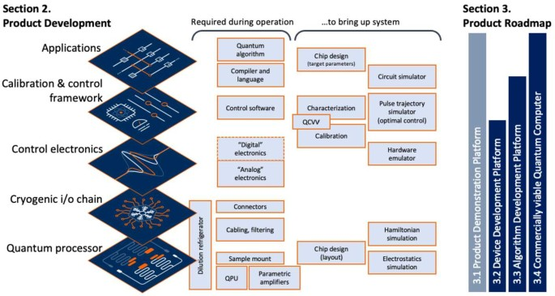
Figure 3- Accelerating quantum computer developments

Slide 4
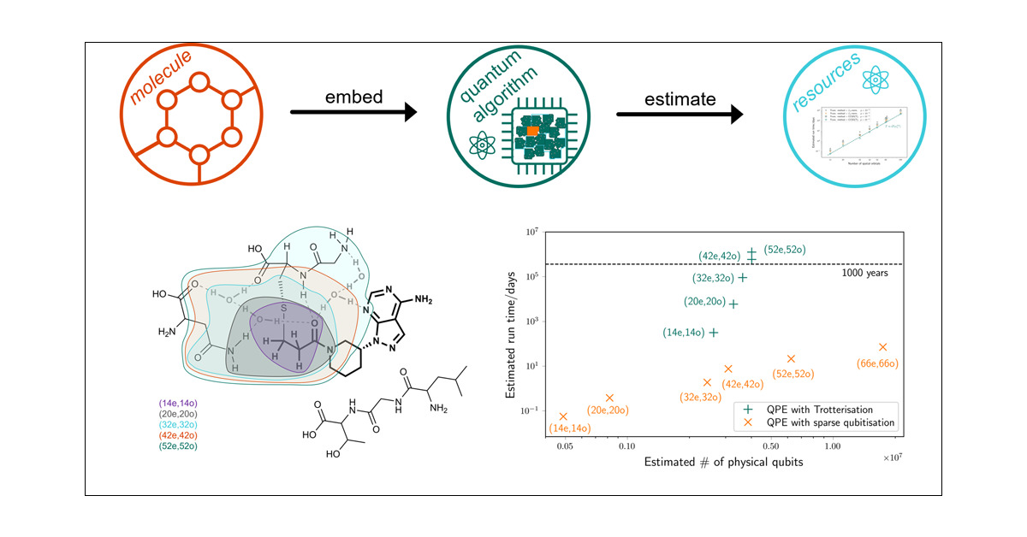
Figure 4- Quantum Computing in drug discovery

Slide 5
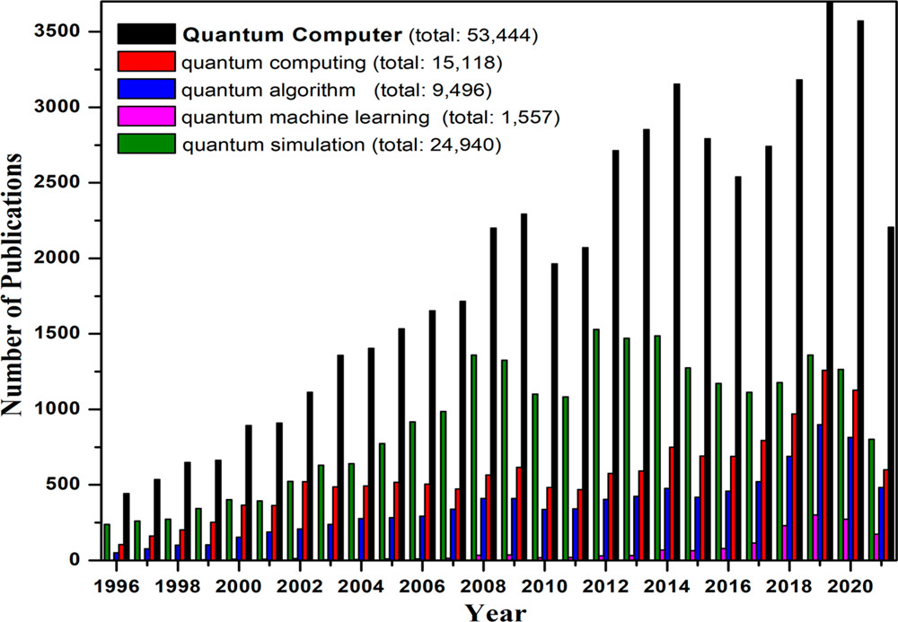
Figure 5 – Quantum Computing and stimulations for energy Applications

